Slide 1
High Performance Lambdas
Steve Upstone UV/Vis Product Specialist
May 2019

Slide 2
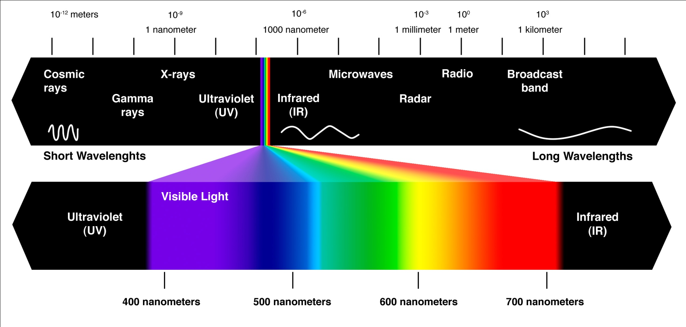
Electromagnetic Spectrum

Slide 3
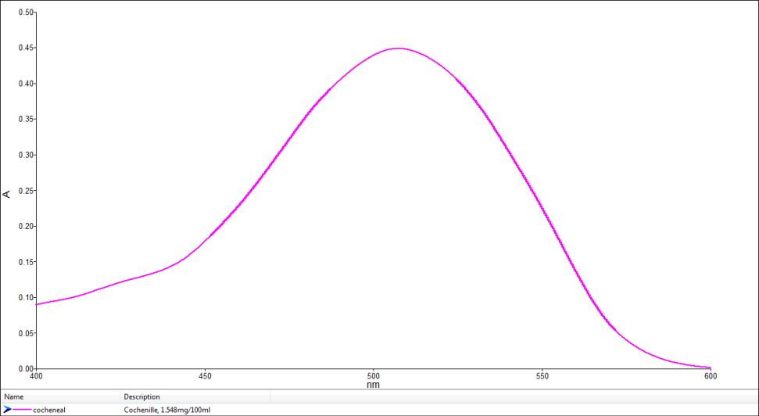
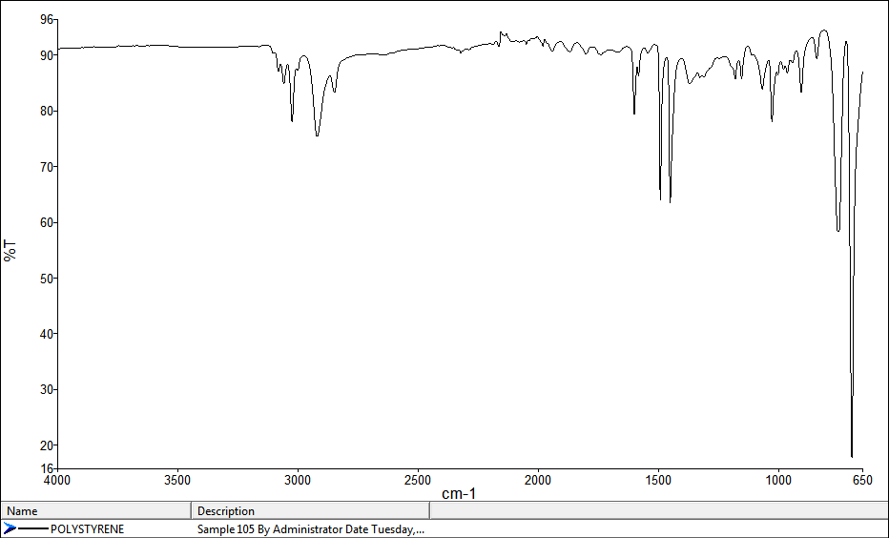
Comparison Between UV and IR
UV Absorption Spectrum
IR Transmittance Spectrum

Slide 4
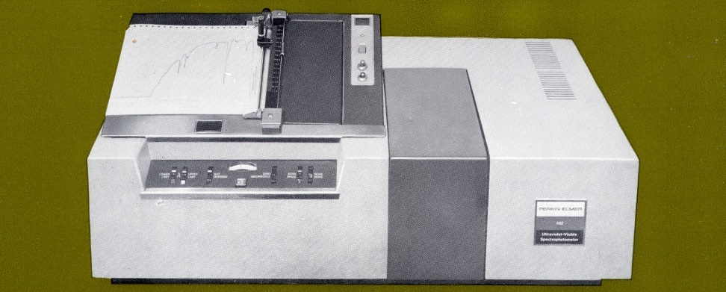
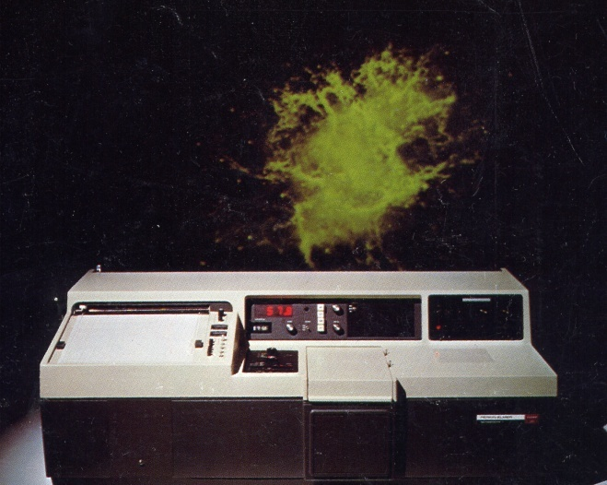
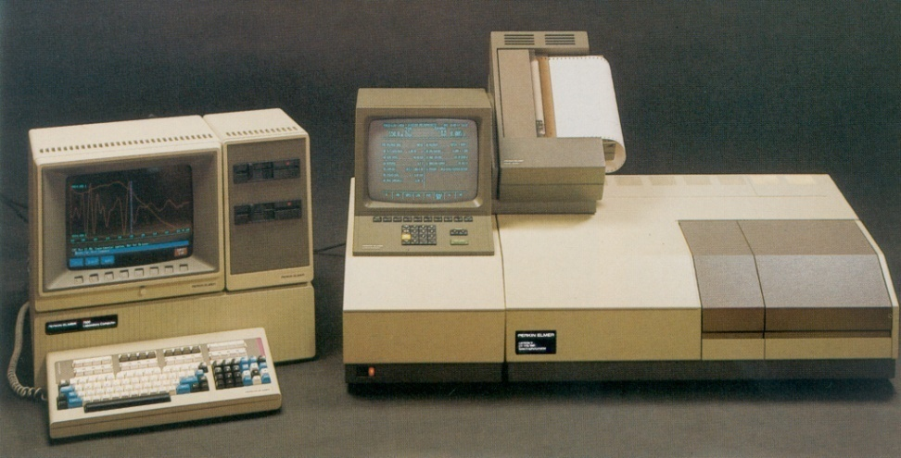
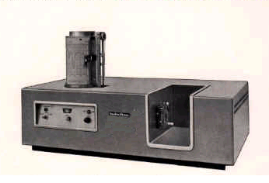
Some of PerkinElmer’s History in UV/Vis and UV/Vis/NIR
402 (1967)
137UV (1957)
Lambda 9 with 7500 32bit computer (1984)
57X Series (1977)

Slide 5
High Performance Lambda Instruments
UV/Vis/NIR | 175-3300 | Up to 8A | 2 or 3 detector system (PMT/PbS or PMT/InGaAs/PbS)
UV/Vis | 175-900nm | Up to 8A | PMT Detector

Slide 6
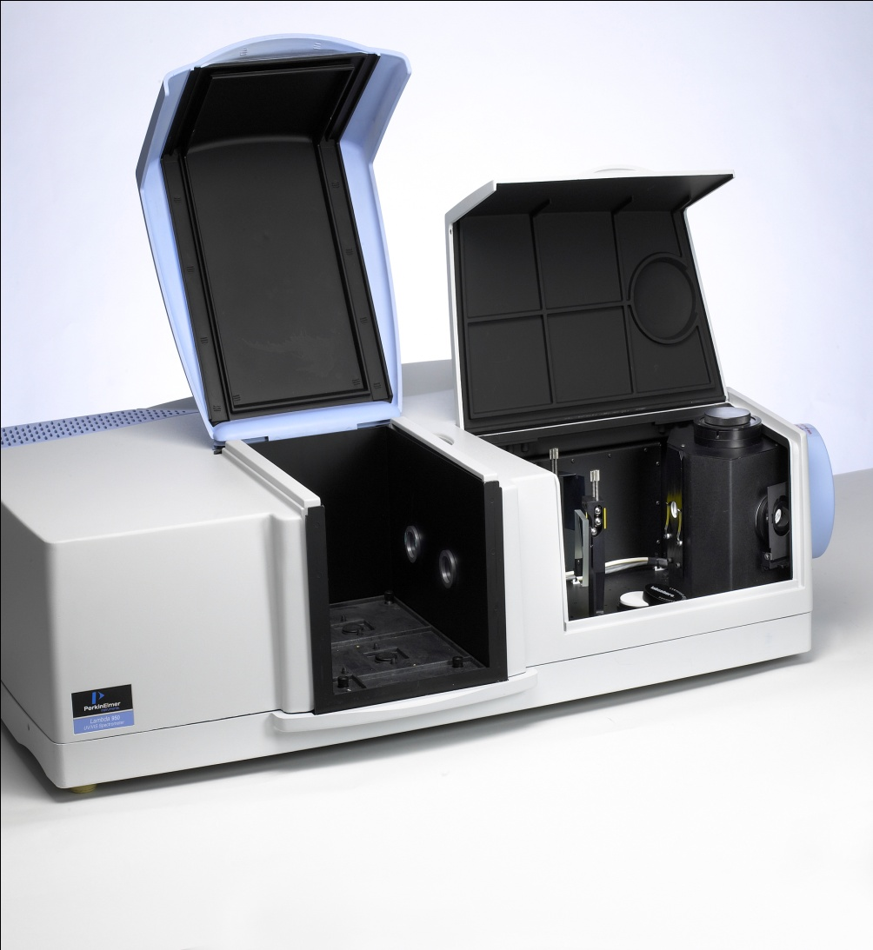
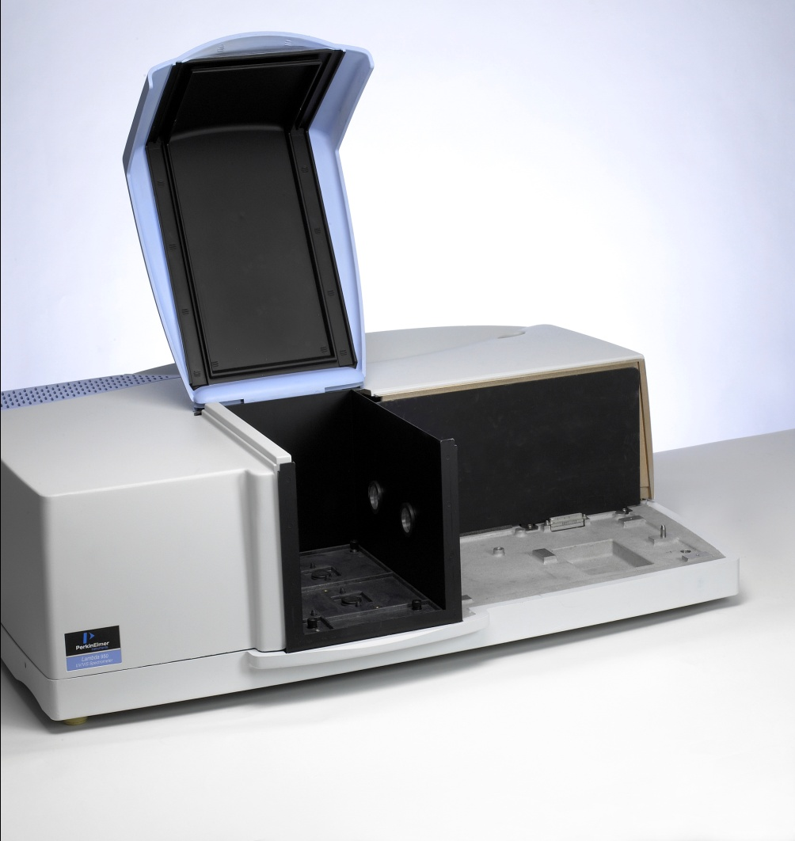
System Concept – Two Sampling Areas

Slide 7
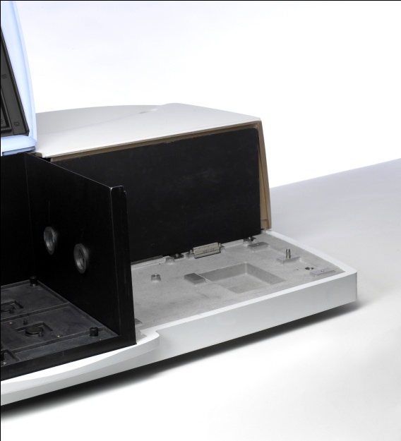
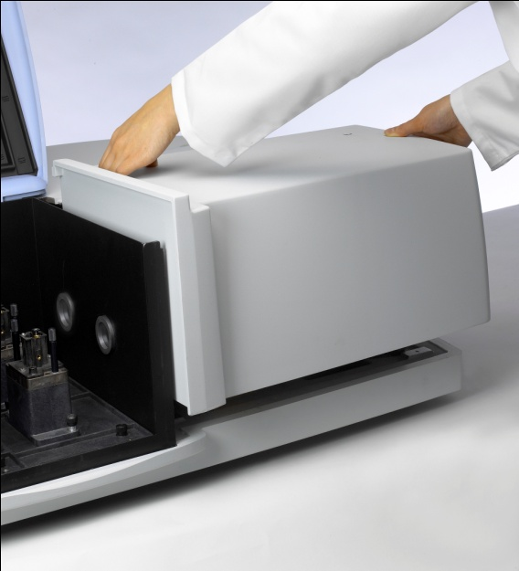
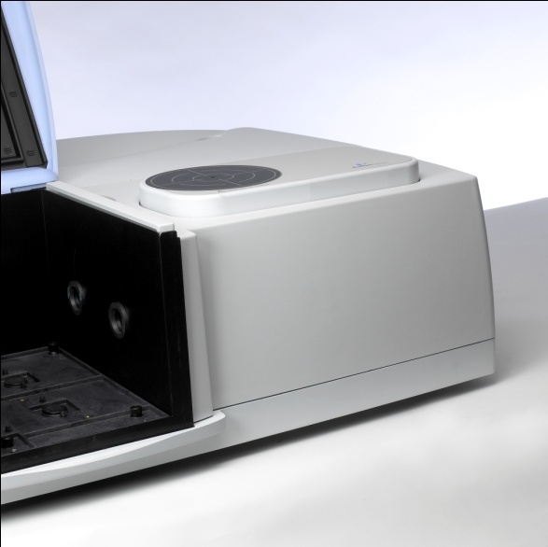
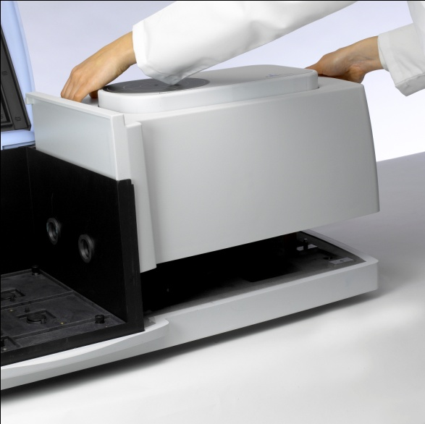
Snap-in Sampling Modules
Transmission
URA

Slide 8
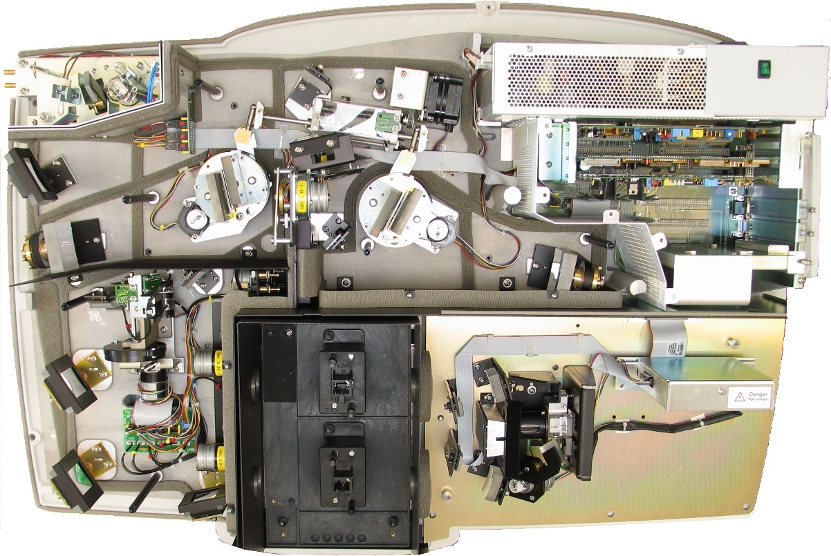
Inside the HP Lambda Instrument (2D Lambda 1050 shown here)

Slide 10
Chopper System (Beam Separator)

Slide 11
Why Is a Double Beam System Necessary?
The reference beam (usually the rear position) is necessary to compensate for changes in lamp energy (which would cause the signal to fluctuate or drift)
The double beam system is also useful when using integrating spheres as it helps to remove some systematic “substitution” errors caused by modification of the sphere behaviour by the sample.

Slide 12
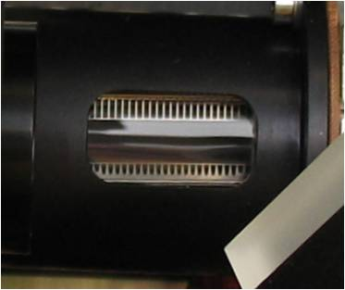
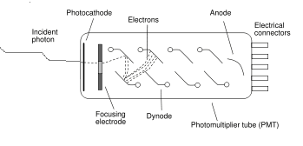
UV/Vis Detector - Photomultiplier
Detector based on a phototube which converts photons to electrons as they strike the phtocathode. These electrons are amplified by the dynode chain until they arrive at the anode.
Photomultiplier requires high voltage (typically around 900V) to operate. This is the gain
When operating in double beam mode (eg Absorbance, transmittance or reflectance), the gain is set automatically by the instrument.
When using either of the two single beam energy modes (E1, E2), the (relative) gain must be set manually via a factor (a value between 0 and 255)
Gridless Hamamatsu R6872

Slide 13
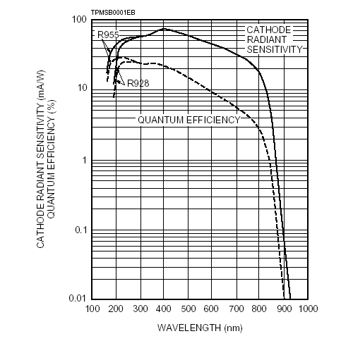
Photomultiplier Response Curve
The HP Lambdas use the gridless R6872 photomultiplier detector which is rated down to 160nm (but the instruments are rated down to 175nm with N₂ purging).
The sensitivity of both detectors drops off rapidly above 800nm

Slide 14
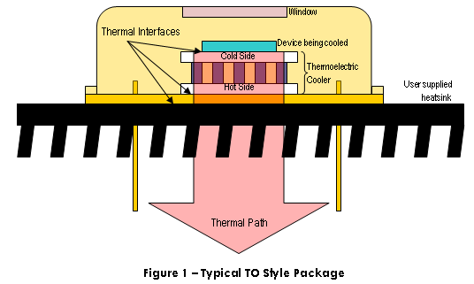

Lead Sulphide (PbS) Detector
The lead sulphide (PbS) detector is used for all wavelengths above the detector change point (normally 860.8 nm)
The detector is cooled to 16°C (using a single-stage Peltier element) to give a constant temperature environment (and, therefore, constant instrument characteristics)
It is a small detector relative to the photomultiplier

Slide 15
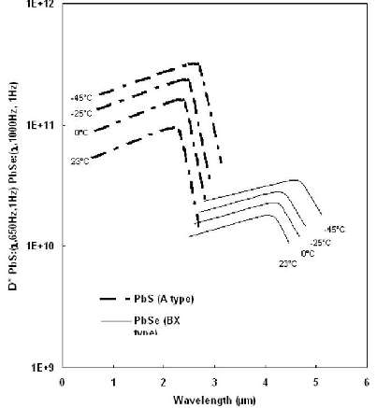
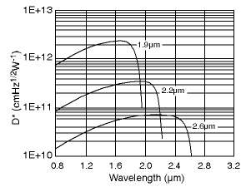
InGaAs Detector technology improves NIR detection
Typical InGaAs performance
Pbs detector typical response

Slide 16
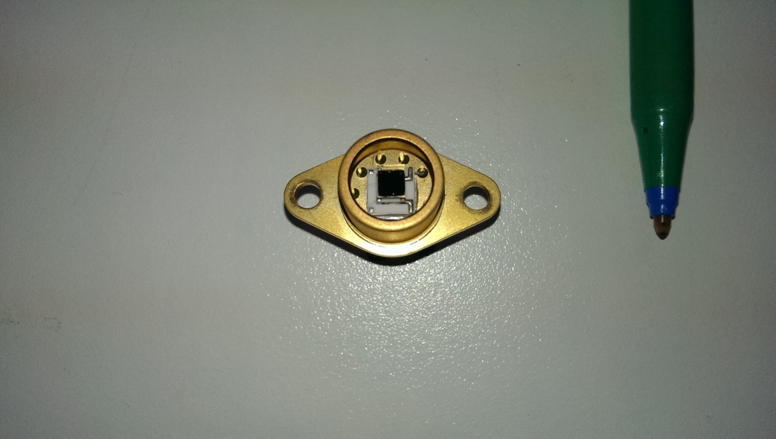
Indium Gallium Arsenide (InGaAs) Detector
InGaAs detector designed to work between 860 and 2500nm
Detector cooled to -50ºC (thermoelectrically)

Slide 17
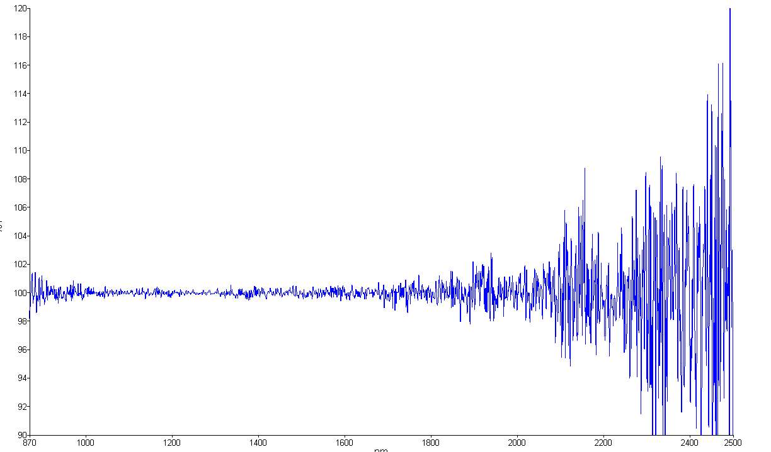
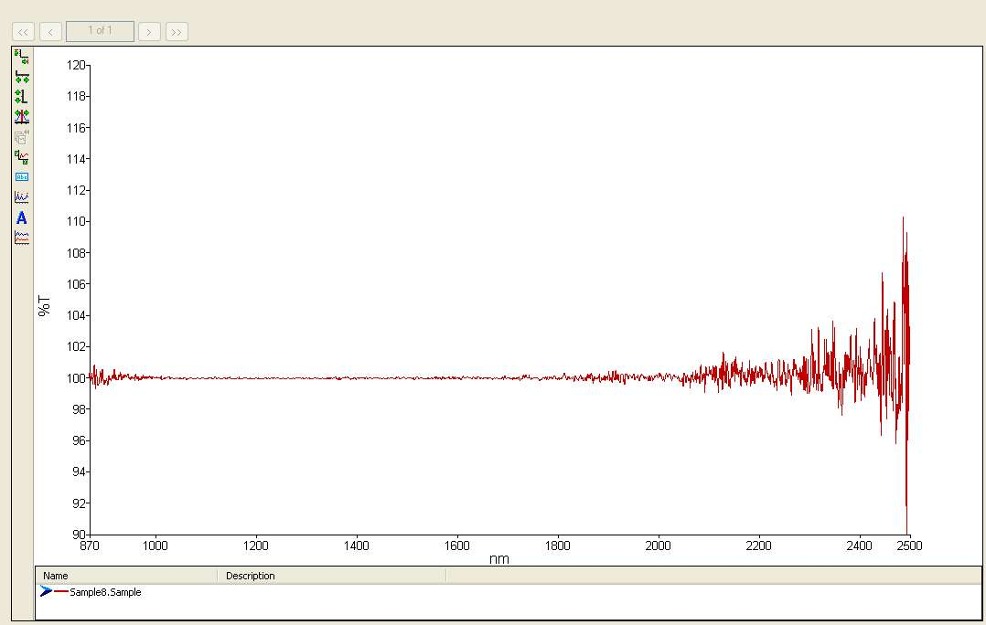
Superior sensitivity of InGaAs compared to PbS for NIR
Pbs Detector / Fixed 2nm slit
WB InGaAs Detector / Fixed 2nm Slit

Slide 18
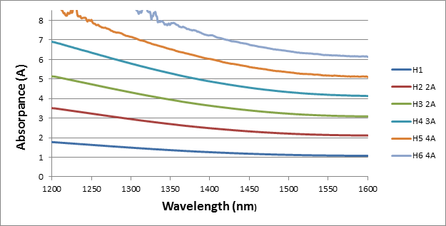
InGaAs NIR Linearity

Slide 19
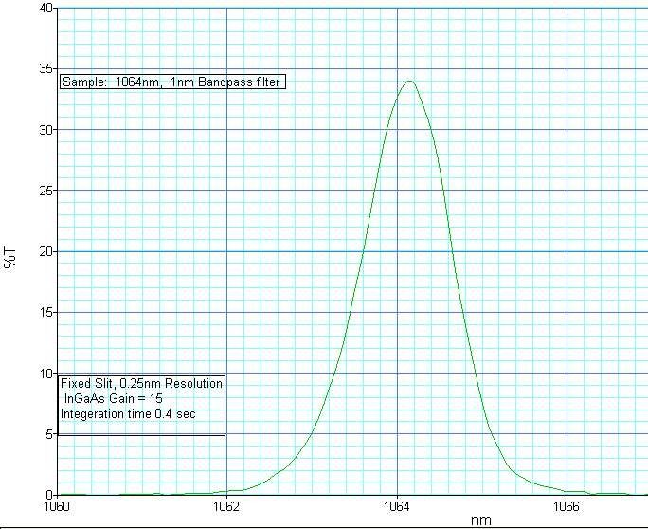
The InGaAs detector provides the best all a round performance
In the range of 860-2500nm.
The majority of applications for High End Spectrophotometers
covers the region from 175nm to 2500nm

Slide 20
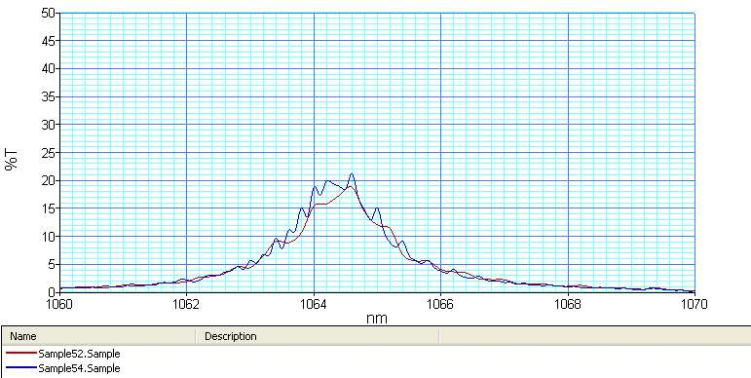
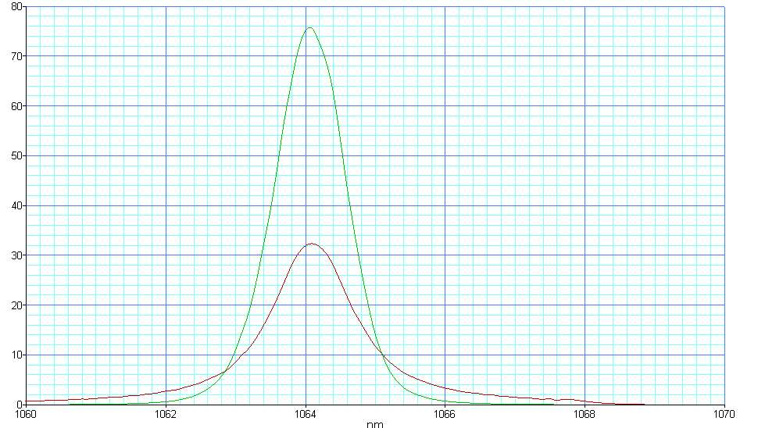
Lambda performance on narrow band (1nm) filter
Pbs Detector with 0.4nm Fixed slit
Experiment w/ InGaAs 0.4nm Fixed Slit

Slide 21
Scan Speed, Response and Data Interval
Steve Upstone

Slide 22
Scan Speed, Response and Data Interval
How the Instrument Works
Chopper Segment Cycle Signal Correction (CSSC)
Trading Rules between Response, Data Interval and Scan Speed

Slide 23
Chopper System Produces Sample and Reference Beams

Slide 24
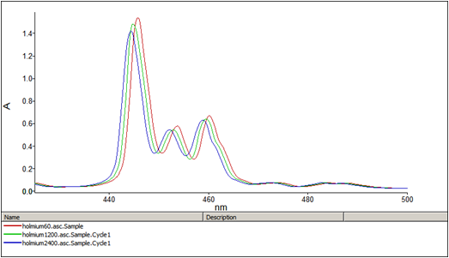
Conventional Chopper (Lambda 9 from 1984) – Scan Speed Dependent Wavelength Shifts if Grating Moves Continuously

Slide 25
Why This Error Occurs
If the monochromator is moving continuously during measurement then the faster the scan speed, the more the grating will have moved between sample and reference measurements.
This time offset produces wavelength shifts and impacts on the accuracy of the system
If the grating is in the same position for both sample and reference readings, the error is eliminated.

Slide 26
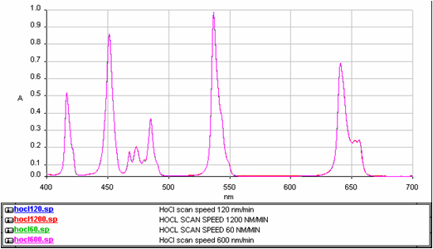
CSSC (Step Scan) Chopper System – Error is Eliminated

Slide 27
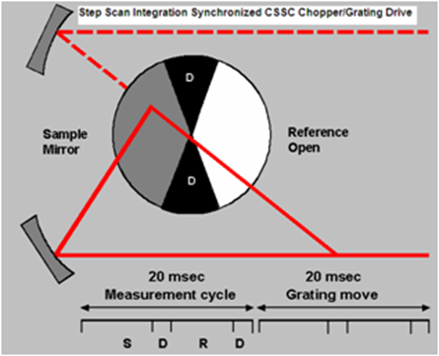
CSSC* System – Read and Move Grating on Alternate Cycles
*Chopper Segment Signal Correction

Slide 28
Chopper Cycle and Response
Each complete reading cycle takes 40 milliseconds (ie 0.04 seconds)
Data can be averaged by increasing the response time (also known as the SAT – Signal Averaging Time) so, for example, a response time of 0.16 seconds would be the average of four readings (ie 4 x 0.04)
Averaging data improves noise according to the square root law that states that the noise will be improved by the square root of the number of readings

Slide 29
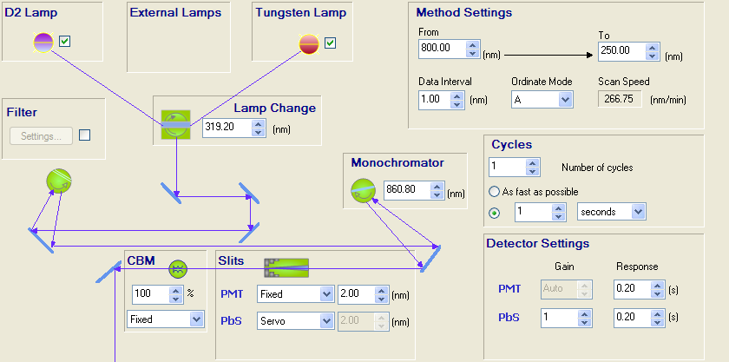

Slide 30
Square Root Law
Response (SAT) Time (seconds) | Number of Readings Averaged | Expected Improvement in Signal to Noise
0.04 | 1 | 1
0.16 | 4 | 2
0.64 | 16 | 4
2.56 | 64 | 8

Slide 31
Scan Speeds for a 0.16 Response Time at Different Data Intervals
Data Interval (nm) | Expected Scan Speed (nm/min)
0.1 | 37.4
1 | 361.0
2 | 696.0
5 | 1570.0
10 | 2700.0

Slide 32
Trading Rules
Out of
Fast Scanning
Low noise
Small data interval
You can choose TWO parameters (ie if you want a small data interval and lower noise, this will result in a slower scan speed)

Slide 33
The Detector “Step”

Slide 34
The Detector “Step”
The detector step normally has its roots in polarisation. Detectors are sensitive to polarisation
Mainly observed
It can also occur due to sample refraction
As standard (ie unless polarisers or depolarisers are used) the instrument produces a polarised beam with polarisation being strongest at the “Wood’s Anomalies” features
Although the step is the most obvious manifestation of polarisation, it can affect the whole spectrum
It cannot be removed at the touch of a button (although its effects can be masked by a combination of software algorithms and smoothing). It is better to understand why it is happening and remove it fundamentally

Slide 35
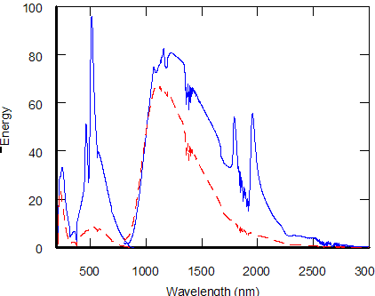
Inherent polarisation from the instrument (mainly from gratings but also mirrors)
Wood Anomalies

Slide 36
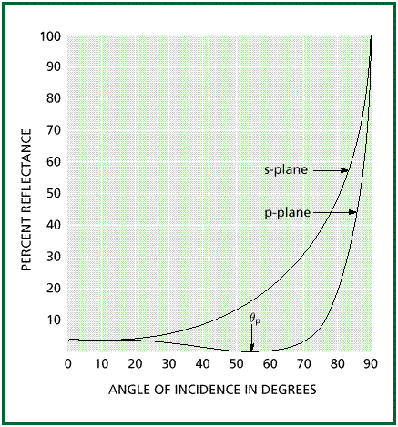
Effect of Angle of Incidence on Polarisation
Samples measured at angles of incidence greater than (approx.) 15 degrees react differently to vertically and horizontally polarised light
This effect is greatest close to the Brewster Angle

Slide 37
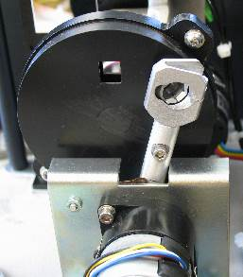
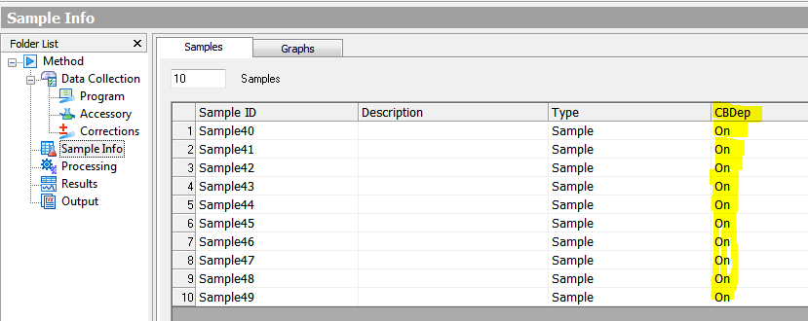

Common Beam Depolariser Accessory (CBD)
The Common Beam Depolariser (CBD) Accessory installs inside the optical compartment of the instrument and is switched in and out through software

Slide 38
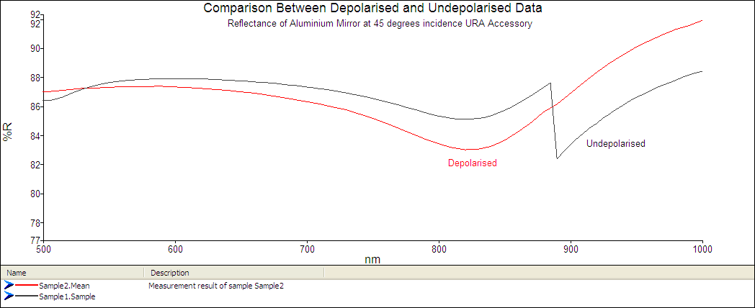
Detector Step and Polarisation State - Reflectance

Slide 39
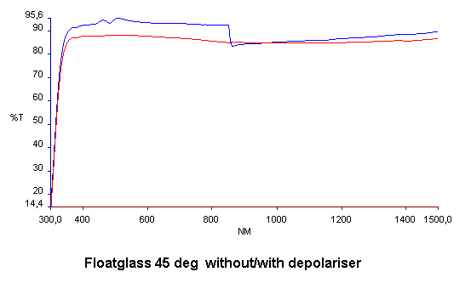
Detector Change and Polarisation State - Transmittance

Slide 40

Detector Step and Refraction
Active area of detector (shown in grey)
Image on detector during autozero (no sample)
Sample introduced – refraction causes beam to illuminate different part of detector (which may not be completely homogeneous)

Slide 41
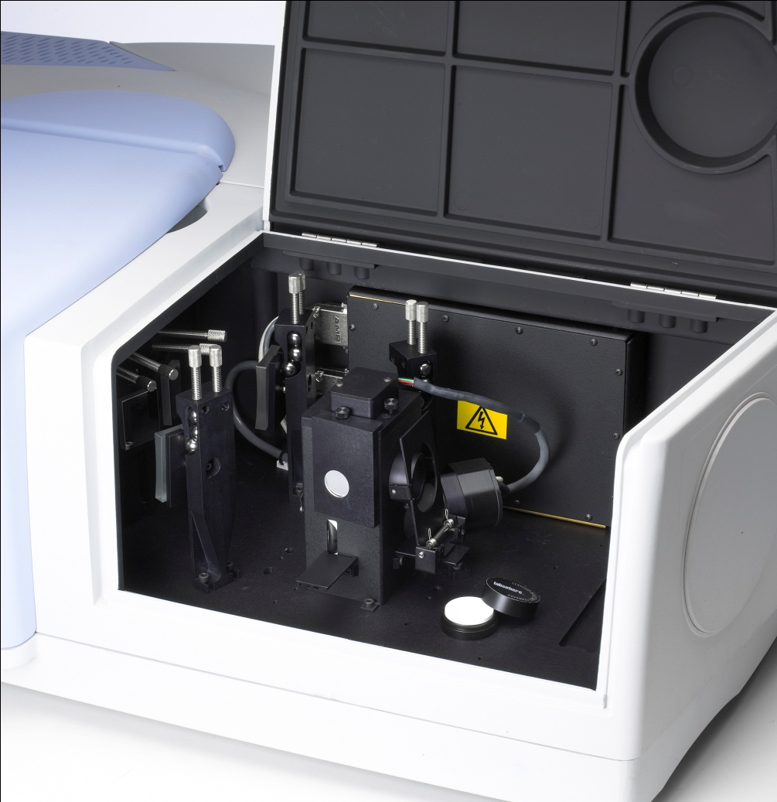
Using an Integrating Sphere to Eliminate the Detector Change
In situations where refraction and/ or multiple internal reflection are causing the beam to shift or change shape, an integrating sphere can be used as a detector
It can be thought of a nearly perfectly homogeneous detector
It is also useful for use with accessories where the beam is inverted between the baseline and sample measurement (eg VN type accessories) or to reduce alignment issues with more complex optical arrangements.

Slide 42
4x Rule
There are four times fewer lines per mm on the NIR grating than the UV/Vis (360 lines/mm cf 1440 lines/mm)
This means that, for the same physical slit width (ie in mm), that the resolution will be 4x larger (eg a 2nm slit in the UV/Vis is equivalent to an 8nm slit in the NIR)
By keeping the physical slit width the same, the polarisation balance is more likely to be conserved

Slide 43
General Recommendations
Polarisation must be controlled at angles of incidence greater than 15 degrees
The “4x rule” minimises changes in polarisation at the detector change by maintaining the same physical beam size
Consider using an integrating sphere as a detector for highly refractive samples

Slide 44
Beam Attenuation for Measuring at High Absorbance
Steve Upstone
November 2009

Slide 45
Overcoming Noise Issues at High Absorbance
Stacked Didymium Filters – no beam attenuation
Notes:
This is a common problem – trying to measure at greater than 4AU without using reference beam attenuation.

Slide 46
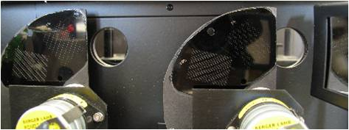
Using Motorised Beam Attenuators to Reduce Noise at High Absorbance
Reference Beam Attenuation (RBA) is a technique to minimise noise when measuring highly absorbing samples
Motorised sample and reference beam attenuators

Slide 47
Full Sequence

Slide 48
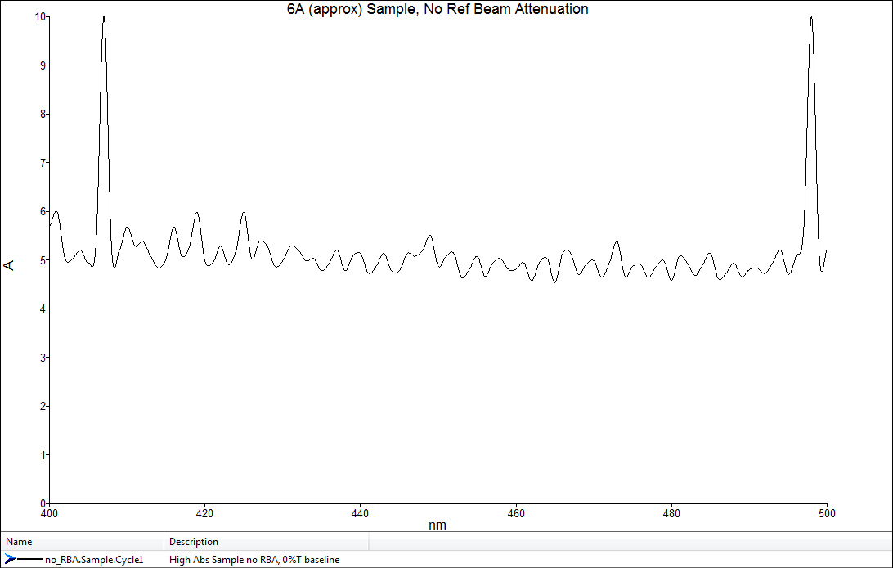
Sample without Reference Beam Attenuation

Slide 49
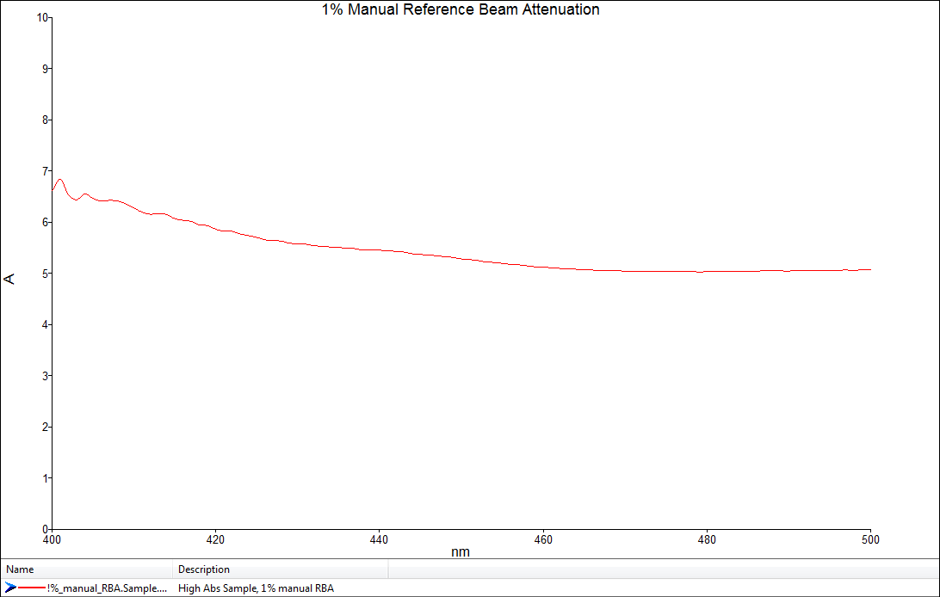
1% Reference Beam Attenuation – Manual Mode

Slide 50
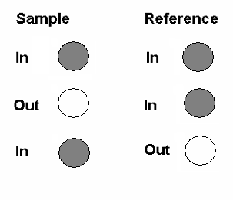
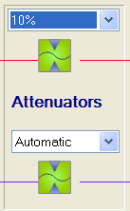
Automatic Mode Beam Attenuators
Gives the best signal to noise for high absorbance/ low transmittance measurements
Three measurements taken – software automatically calculates and removes contribution from the attenuator

Slide 51
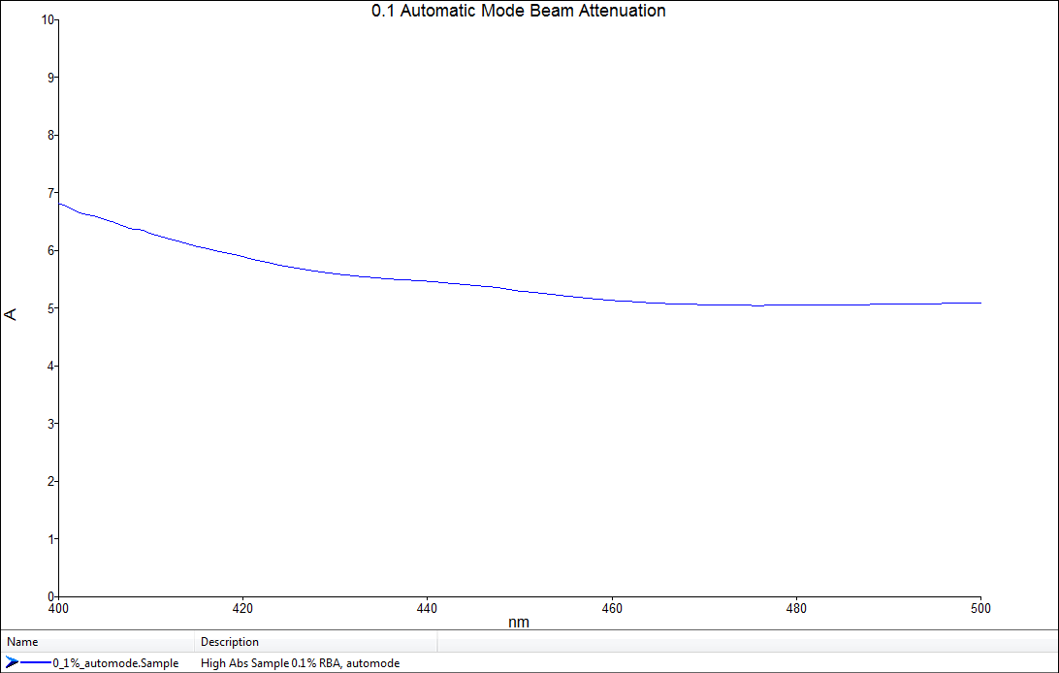
0.1% “Automode” Beam Attenuation (Lambda 1050)

Slide 52
Automatic Mode Reference Beam Attenuation for Low Noise at High Absorbance
This slide shows the superior results at high absorbance when using the unique automatic mode of reference beam attenuation

Slide 53
Maintenance

Slide 54
Maintenance
Calibration
Service Methods for checking performance
Changing lamps

Slide 55
Calibration
Calibration is a procedure for checking and correcting for any small drift in slit and wavelength accuracy
If your instrument has a standard detector (either 2D or 3D) the procedure is best done using that
The procedure takes between 5 and 10 minutes

Slide 56
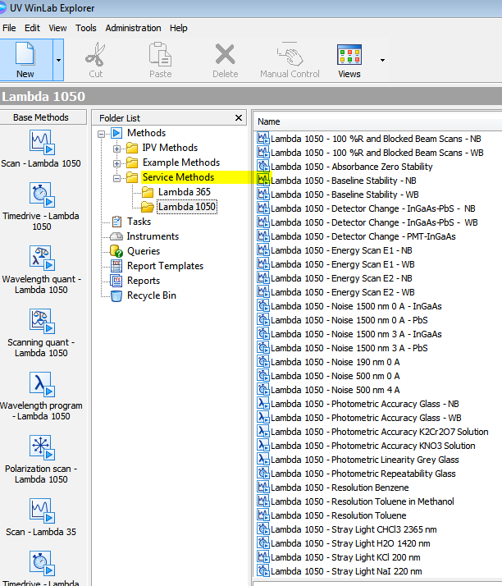
Service Methods
Service methods are used to check instrument performance
There is a large “library” of tests that check things like wavelength accuracy, stray light, absorbance accuracy etc.
Some tests require test materials (e.g. glass filters or test solutions) but others do not.

Slide 57
Sampling Options for the Lambda 1050

Slide 58
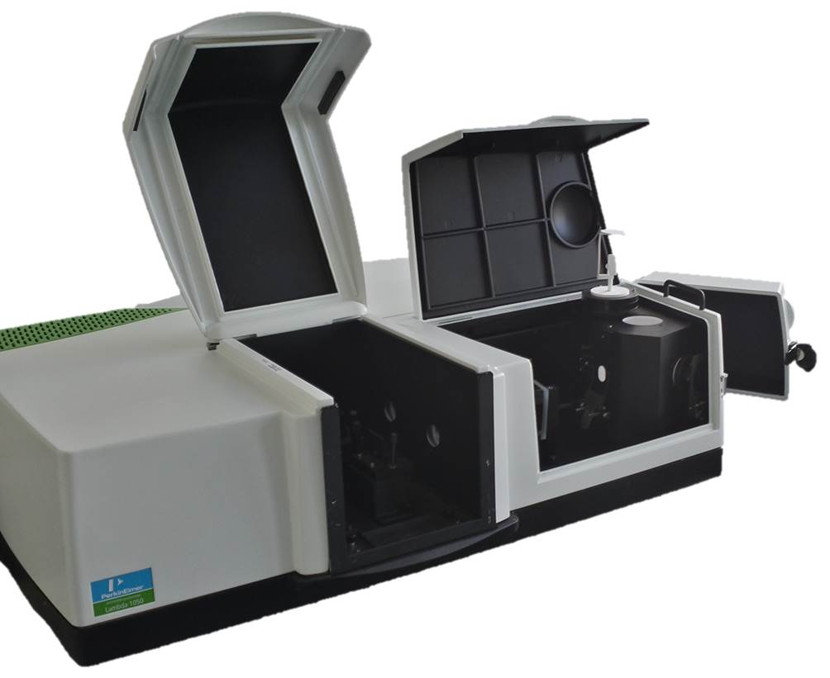
Lambda X50 Series with 150mm Integrating Sphere

Slide 59
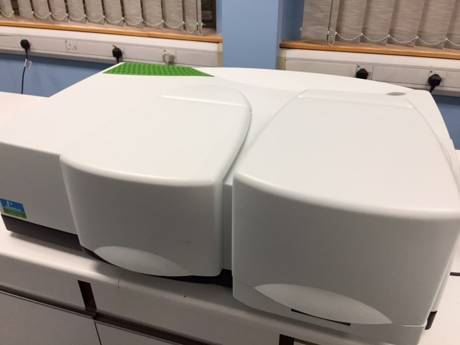
Lambda X50 Series with TAMS* Goniometer
* Total Automated Measurement System

Slide 60
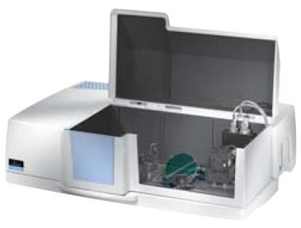
General Purpose Optical Bench (GPOB)

Slide 61
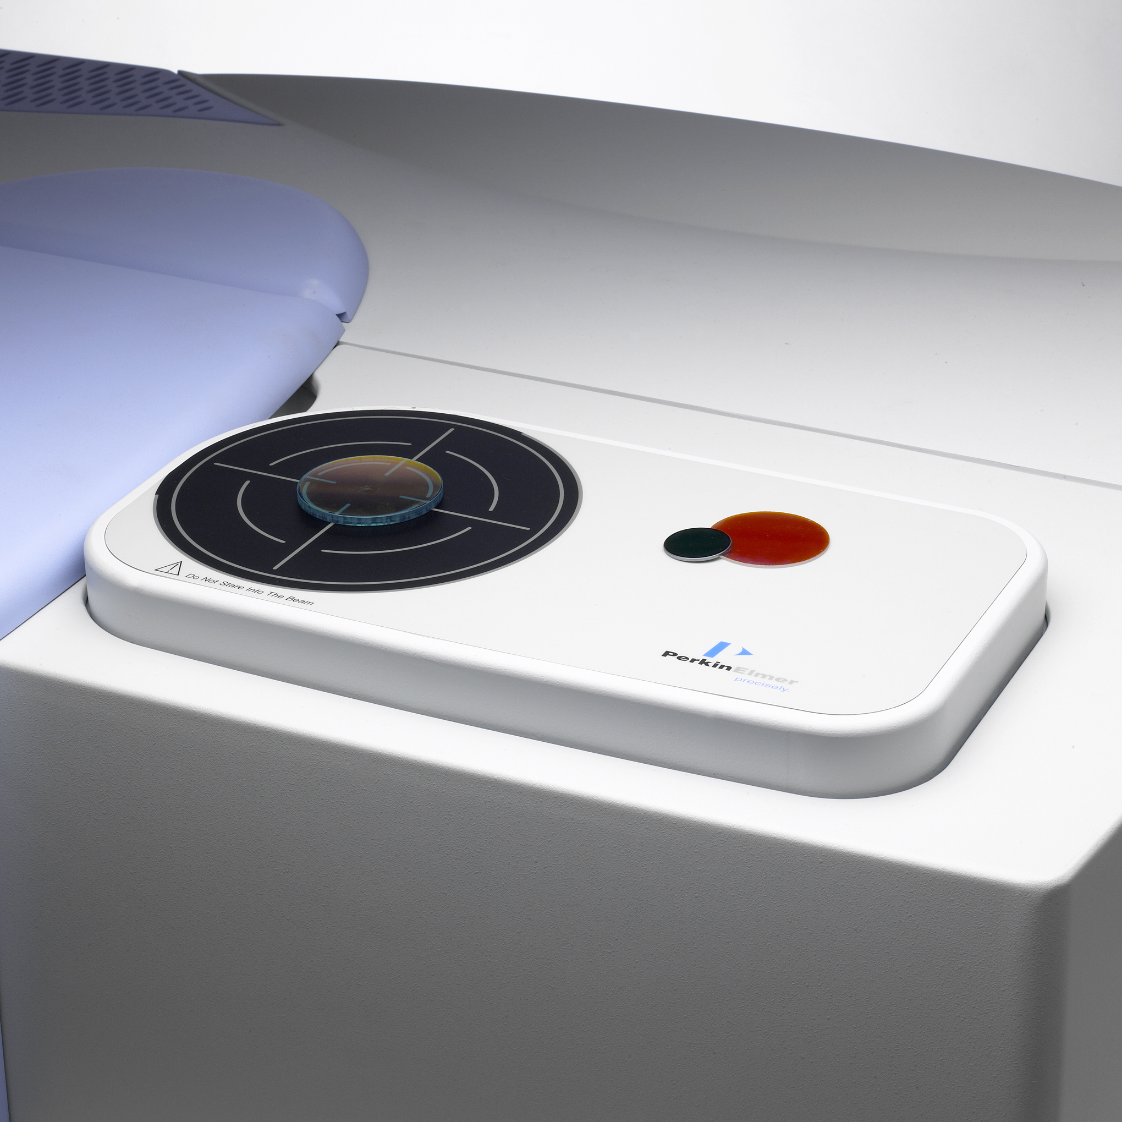
URA Accessory for Measuring Specular Reflectance of Small Components

Slide 62
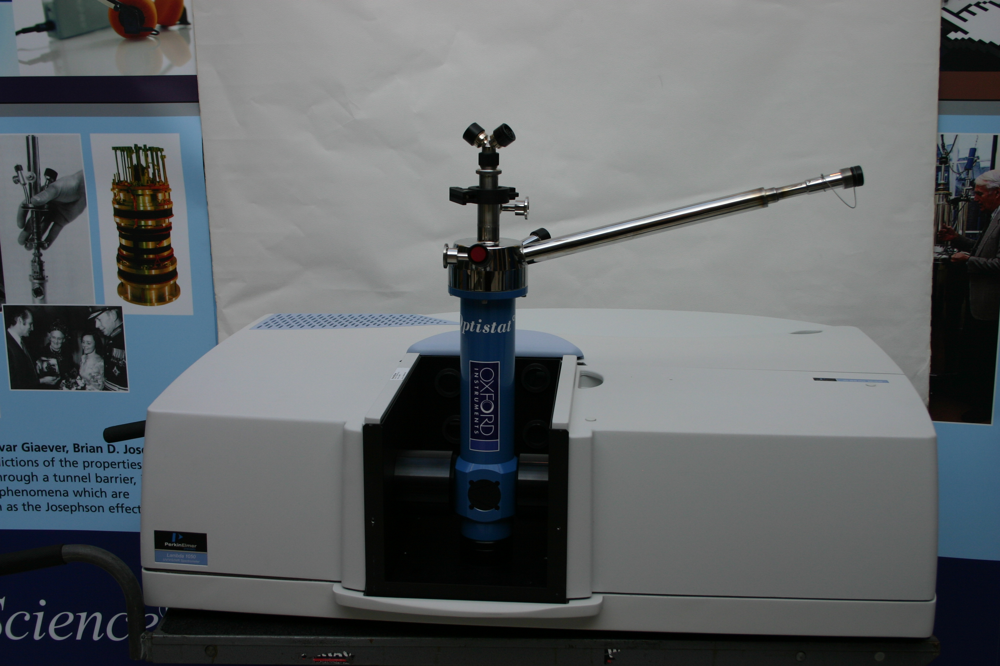
Oxford Instruments Optistat CF and DN Cryostats

Slide 63

Questions?
Notes:
Questions

